Slide 1

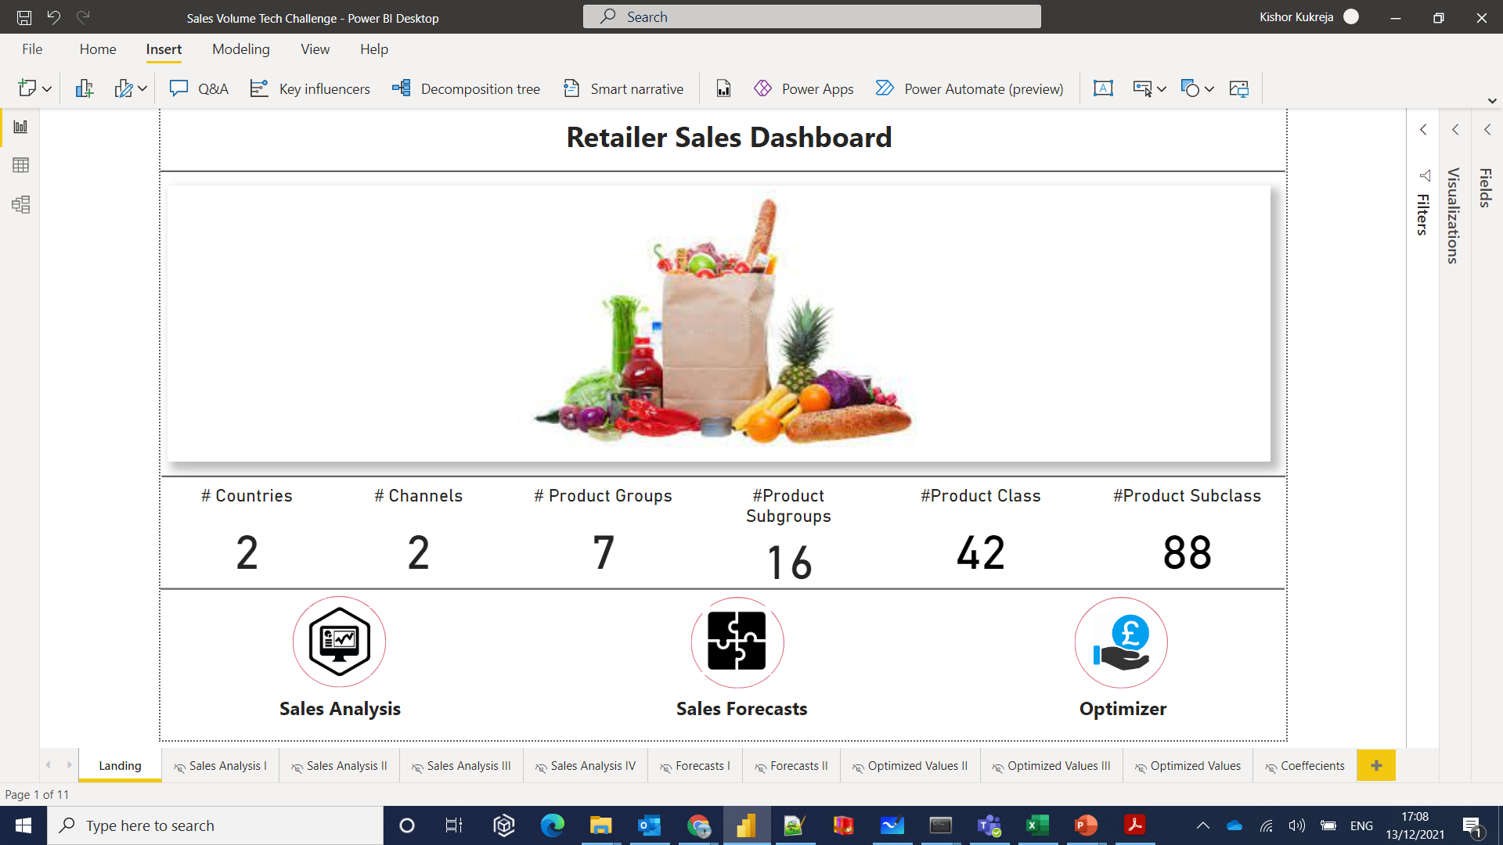
Sales Volume - Pricing Optimisation
Recommending a weekly price change schedule for highest Gross Margin Profit

Slide 2
THE JOURNEY
|A

Slide 3




Sales Volume Forecasting Journey using 4 key steps
Solution Framing
SLSQP Optimization
Sales Volume Forecasting
Volume Price
Equation
Using the simulations to understand the impact of factor/constraint changes on output variable
Scenario building to optimize the Sales volume on different price ranges and assessing the optimal price recommendation for a product.
Outcome: The output will be optimized sales volume and selling price constrained on the cost and the volume.
Insights
Use factors and guidance in tree-based modelling approach
Sales volume forecasting using bagging method along with other variables to predict future demand.
Outcome: Model per Product Group-Channel- Country combination
Modelling Linear Regression to volume-price fit
Both volume and Price is dynamic and depend on each other. Very high price will reduce the sales and very low price will reduce the gross profit
Outcome: Linear equation for each Product-Channel-Country combination.
Insights on the data dictionary and observable patterns
Outcome: Multiple short- and long-term insights and trends observed from the data. This also shapes the ground for modelling work

Slide 4
Setting up the solution framework for success
Estimate an equation between Sales Volume and Price for each Product at weekly level.
Both Sales Volume and Price is dynamic and depend on each other. Very high price will reduce the sales and very low price will reduce the gross profit.
Factors considered:
Current Price, Previous Price, Original Price
Cost
Cyclic temporal Features, Week, Month, Quarter
Country Dynamics
Channel Dynamics
Optimizing Current Selling price w.r.t Sales Forecast
Constraints to be considered:
Volume between 100-130% of Forecasted Volume
Current Selling price Between Cost to Original Selling Price
Optimize the Total Revenue
Recommend Weekly price based on forecasted sales for 13 future weeks
Volume-Price Equation
Optimization
Forecast Sales for each Product at weekly level using historical Demand data using Machine Learning
Factors to be considered:
Lags of Sales
Mean Encoding
Weighted Past Sales
Price Trends
Product Hierarchies
Cyclic temporal Features, Week, Month, Quarter
Sales Forecasting

Slide 5
INSIGHTS
|B

Slide 6




Insights of Sales Volume - Price
Where ?
What ?
Which ?
Price ?
Quadrants
Region
Products
Product Groups
Price
Quadrants
95% of the Sales are accounted by Stores
94% of Sales Volume are by Country B
Season L has most of the Products being sold at distinct 1857 combinations.
Stores sells more product combinations as compared to Online
﻿26387251 accounted for 56.58% of Sales Volume with 41% of product combinations.
Across all 7 Product Groups, Mean Price ranged from 13.11 to 26.36 .
Mean OSP and Mean CSP diverged the most when the product group was 26387251.
At 26.36, 3bc0de94 had the highest Mean CSP and was 101.00% higher than 606565a1, which had the lowest Mean CSP at 13.11.
Product groups can be divided into 4Quadrants on Volume-Mean CSP basis.
Products within a quadrant- channel-country behave similarly

Slide 7

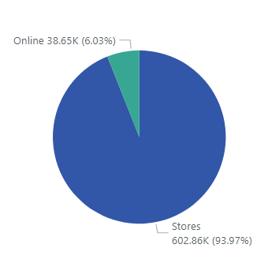
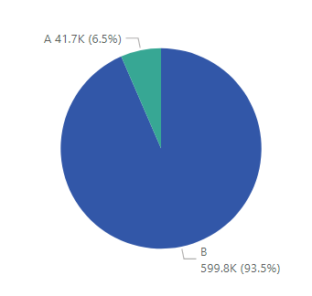
Where volume behavior ?
95% of the Sales are accounted by Stores
94% of Sales Volume are by Country B
BY Channel
By Country

Slide 8
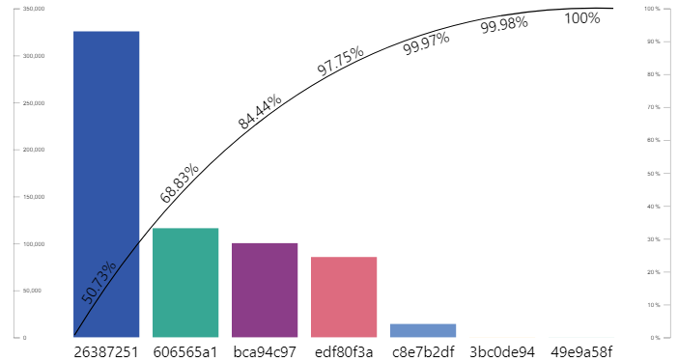
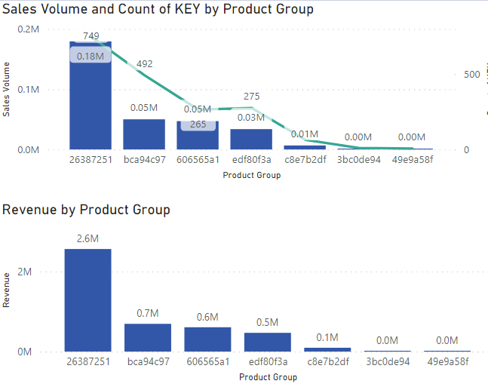
Which volume behavior ?
﻿26387251 accounted for 56.58% of Sales Volume with 41% of product combinations.
Across all 7 Product Groups, Mean Price ranged from 13.11 to 26.36 .
3 top product groups make up 85% of volume
26387251 alone makes up 52% of Revenue

Slide 9
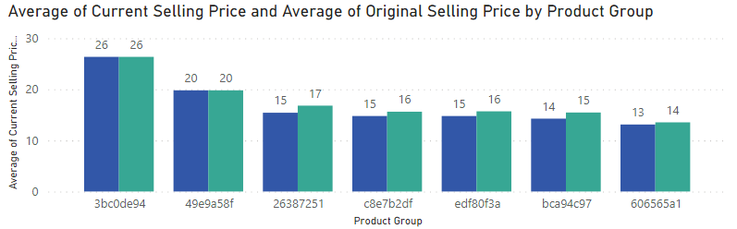
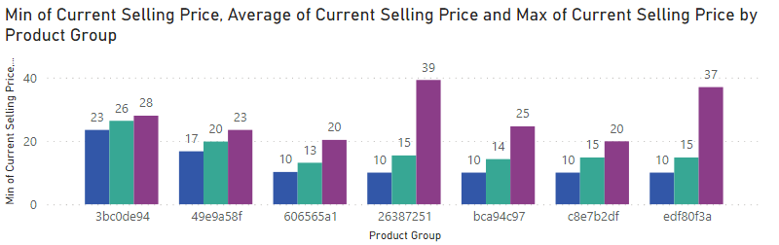
Price behavior ?
﻿Mean OSP and Mean CSP diverged the most when the product group was 26387251.
At 26.36, 3bc0de94 had the highest Mean CSP and was 101.00% higher than 606565a1, which had the lowest Mean CSP at 13.11.
3bc0de94 has the least Δ between CSP & OSP
26387251 has the highest Δ among MSP

Slide 10
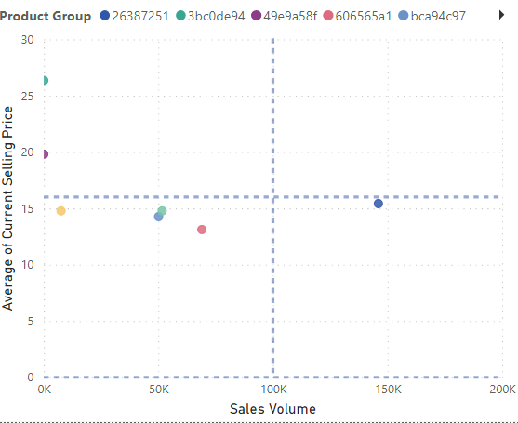
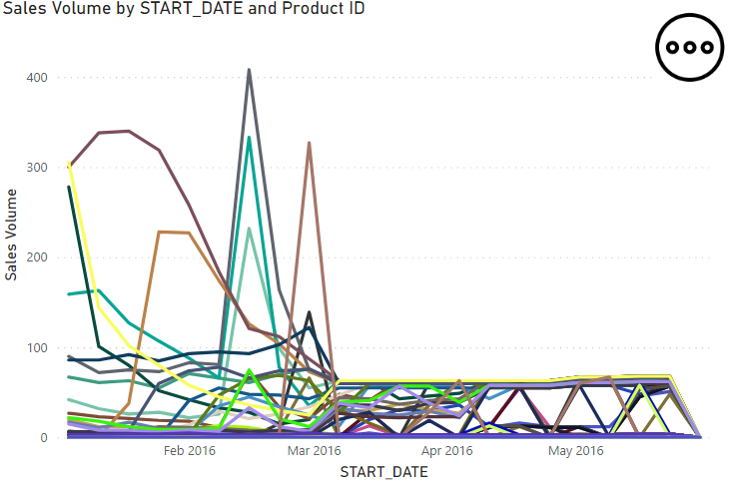
Quadrant behavior ?
﻿Product groups can be divided into 4Quadrants on Volume-Mean CSP basis.
Products of a quadrant- channel-country behave similarly
26387251 is high volume Mid price segment
Within-Groups products behave similarly

Slide 11

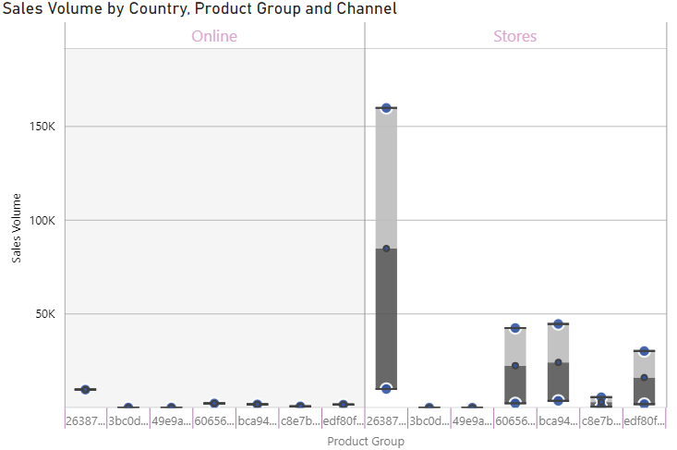
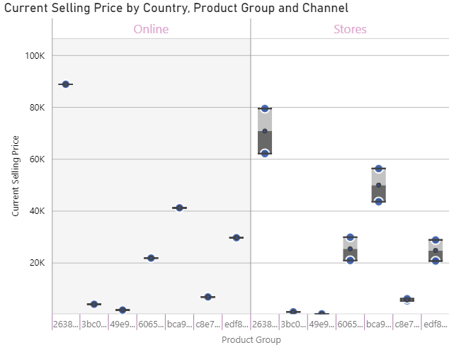
Channel – Country behavior ?
﻿Significant variation of Volume between Channels & Countries
Significant variation of Selling Price between Channels & Countries
Significant variation of Volume between Channels & Countries
Significant variation of Selling Price between Channels & Countries

Slide 12
VOLUME – PRICE EQUATION
|C

Slide 13
Assumptions and Observations
9% ΔCSP/OSP
4% ΔPSP/OSP
Assumptions :
Minimum Cost price is assumed to be 50% of Lowest Selling Price.
Maximum Cost price is assumed to either 25,33, or 40% of Lowest Selling price depending upon the product group
Minimum Selling price between Maximum Original Price and Maximum Cost price
Observations :
Correlation between Sales and price is high and exhibit temporal behavior.
Some combinations have a seasonal behavior picking up in March and the falling back to September and again rising.
Sales are quite low in September.
Price Change w.r.t Original and Previous price have been found informative features
Within-groups products are behaving similarly

Slide 14
Volume–Price equation deep dive
Since products have significant variations between channels and countries
Goodness of Fit
Fit Level :
Product- Channel - Country Level fit : 1861 Combinations
Duration : 2015 – 2016
Weeks: 60
Model Used: Multi Linear regression
Dependent variable: Sales Volume
Independent Variables:
Price: Current Price, Original Price, Previous Price
Cost: Maximum Cost
Time: Year , month, week, Week of month
Seasonality (Fourier): Week and Month
Indicator variables : Is Month Start, Is Month End, Is Quarter Start, Is Quarter End, Is Year Start, Is Quarter End
Regression Fit per Product-Channel-Country
Sales Volume= intercept + α*Current Price+ β*Original Price + ……
*Weights are calculated using Volume sold
578 combinations have a R-squared >0.8, 95% Combnations have R Quared >0.5

Slide 15
SALES VOLUME – FORECASTING
|D

Slide 16
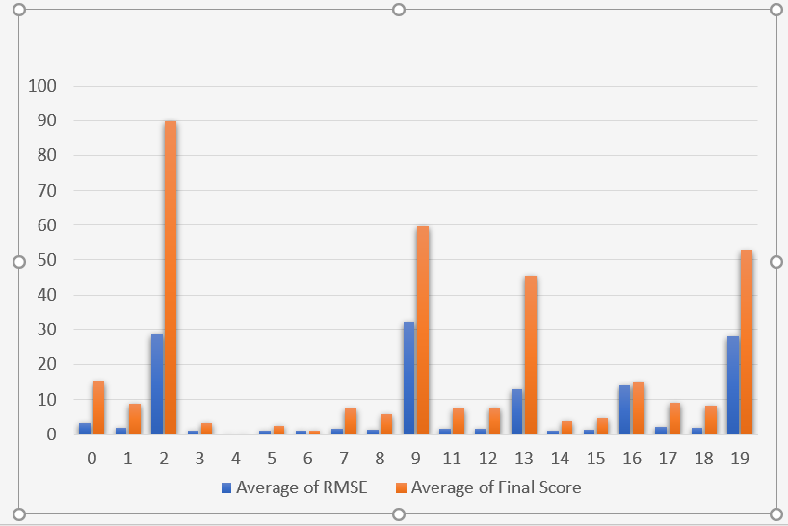
Sales volume forecasting deep dive
Since products have significant variations between channels and countries
Goodness of Fit
Fit Level :
Product Group - Channel - Country Level fit : 19 Combinations
Duration : 2015 – 2016
Weeks: 60
Model Used: Random Forest
Dependent variable: Sales Volume
Independent Variables:
Price: Current Price, Original Price, Previous Price
Time: Year , month, week, Week of month
Seasonality (Fourier): Week and Month
Indicator variables : Is Month Start, Is Month End, Is Quarter Start, Is Quarter End, Is Year Start, Is Quarter End
Known Reals : Lags of Volume, Weighted Average of Past weeks, Mean encoding at different hierarchies
Random Forest Model per Product Group -Channel-Country
*Min Max Scaling Used || 25 Evaluations || Bayesian Optimization
Tracking Signal Bias And RMSE Used for Hyper parameter Tuning

Slide 17

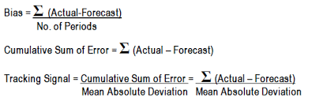


Hyper-parameter objective function
Signal Bias
[TSB]
Combinations within product group- Channel - Country
Dual Objective Optimization
Minimize: RMSE so that Sales Volume can be rightly forecasted
3.75
Bounding:
Tracking Signal bias should be between -3.75 to +3.75 for an efficient model, we are neither highly over or under forecasting.
0
1
RMSE
-3.75

Slide 18
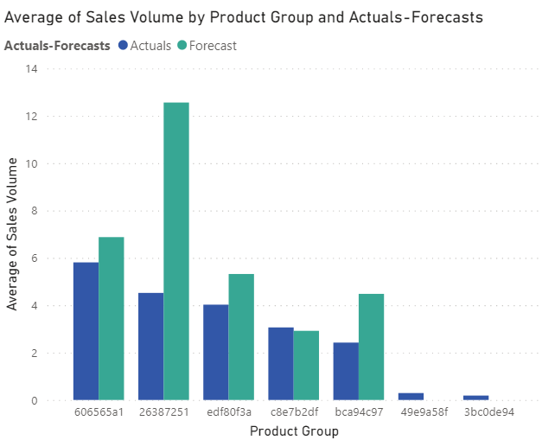
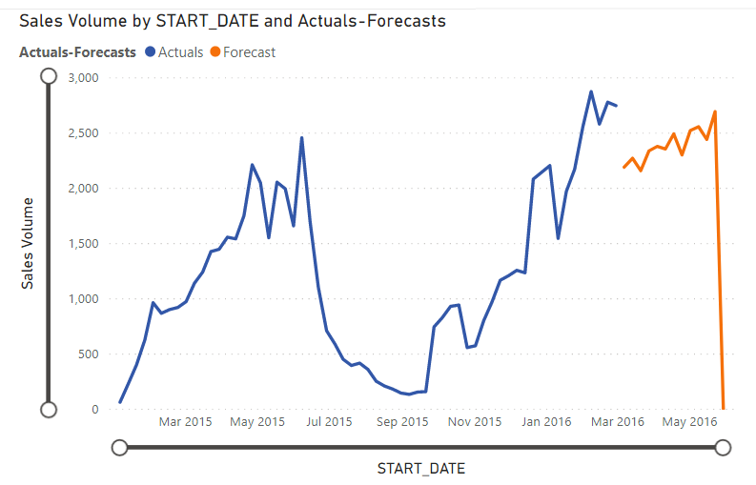
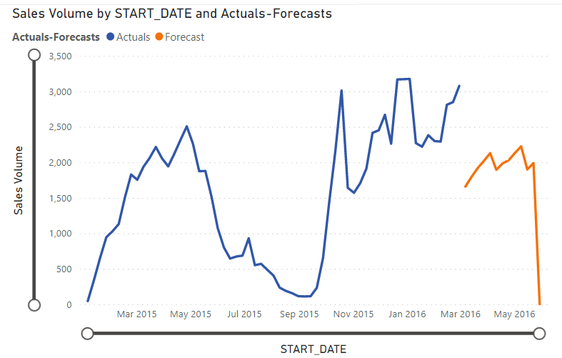
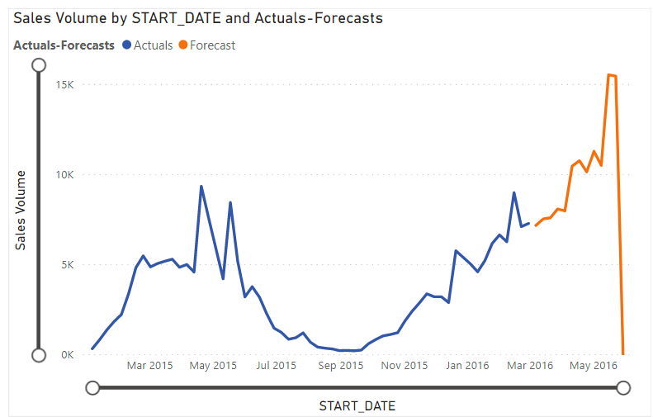
Sales volume forecasting results
Sales Forecasting Model is able to capture trends within the product groups
Product group Wise Average deviation Between Actuals and Forecasts

Slide 19
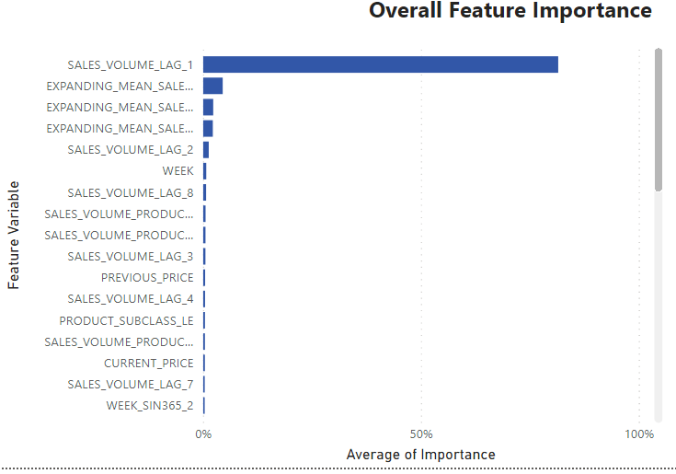
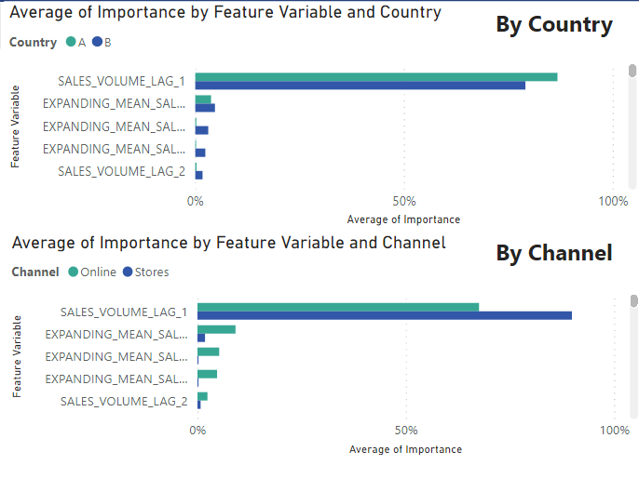
Sales volume forecasting feature importances
Feature Importance among product groups
Feature Importance among Channel & Country

Slide 20
SQLSP OPTIMIZATION
|E

Slide 21

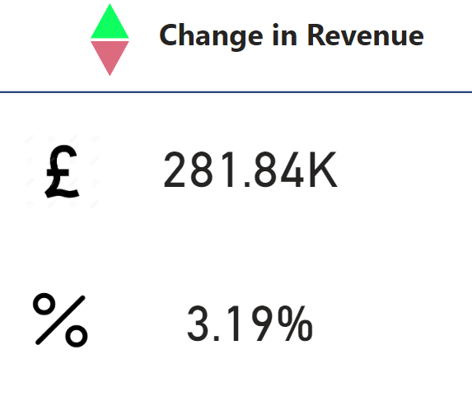
Optimization Deep Dive
Maximum Gross Profit by simulating Volume sold and Current price
Goodness of Fit
Constraints :
Upper and Lower Bound on Sales Volume:
Lower Bound = Sales Forecasts
Upper Bound : 1.25*Sales Forecasts
Upper and Lower Bound for Selling Price :
Lower bound = Minimum Selling Price
Upper bound= Maximum Original Price
Equality Relationship between Sales Volume, Current Price, Cost Price and Time :
Sales Volume Price equation Fit
Final equations : Maximum Gross Profit and Sales
Recommendation for price change schedule :
Based on the above algorithm, we can get the prices and forecast for each week or each month.
Using the variation in price change data, we bin prices in sizes of 2-5£.
The Start date and End date is then suggested if the price range changes.
Sequential Linear Squares Programming – SLSQP Heuristics
281K Increase in overall revenue post Optimization
3.2% Increase in overall revenue post Optimization

Slide 22

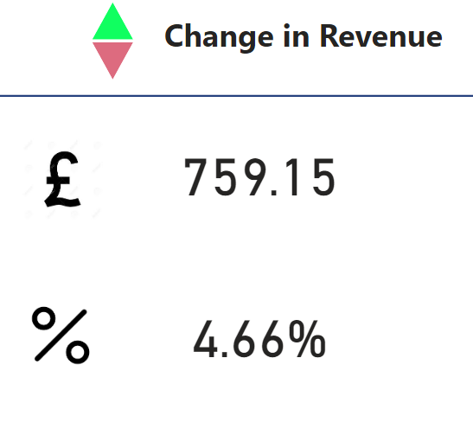
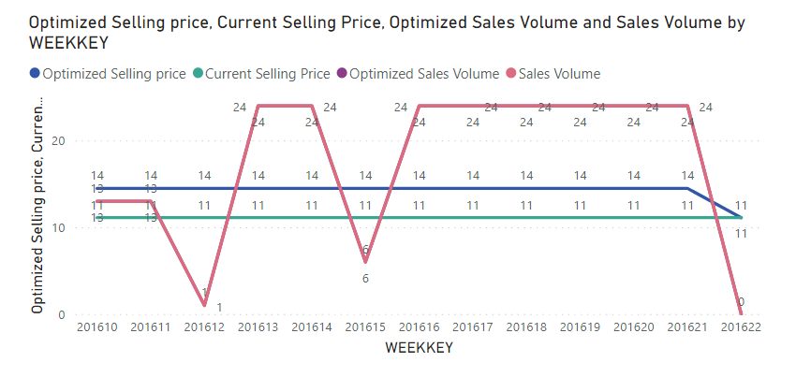
Optimization Results → 10516724 - Stores - B
Maximum Gross Profit by simulating Volume sold and Current price
Change in CSP to 14 from 11 £ increases revenue by 5%

Slide 23

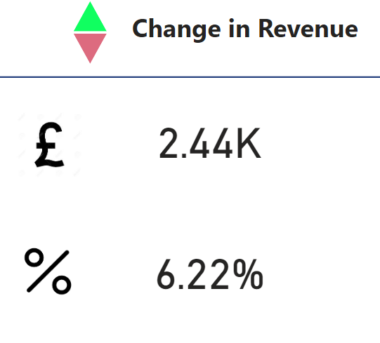
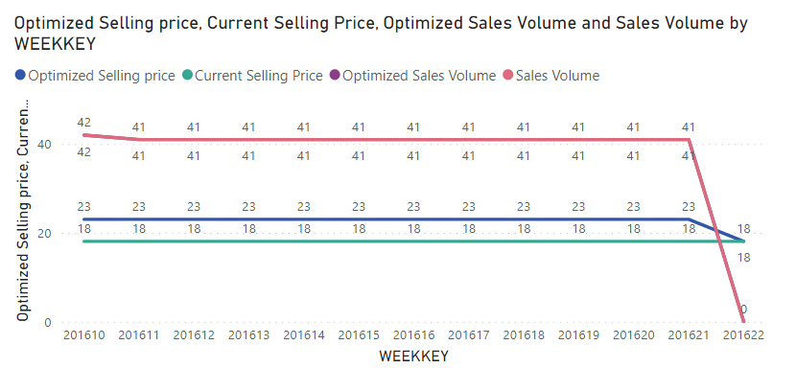
Optimization Results → 1abf90df – Stores- B
Maximum Gross Profit by simulating Volume sold and Current price
Change in CSP to 23 from 18 £ increases revenue by 6%

Slide 24

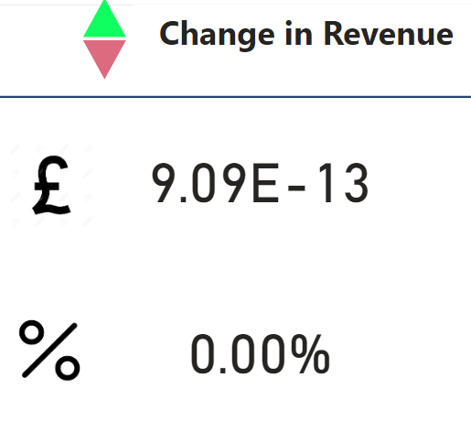
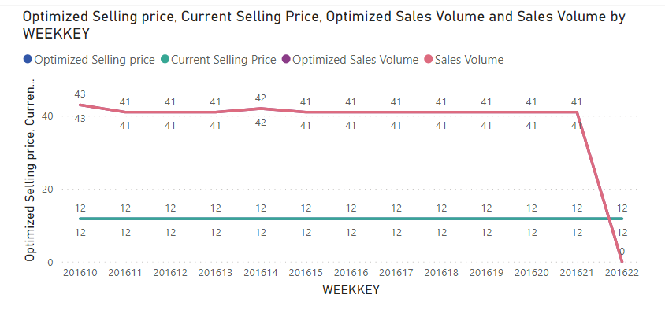
Optimization Results → 29bfe91e – Stores - B
Maximum Gross Profit by simulating Volume sold and Current price
No Improvement. Recommendation is to sell at CSP of 12£

Slide 25



Any questions ? Let’s collaborate

